Slide 1
Like to vs. would like to
Basic 07 – Unit 7a

Slide 2
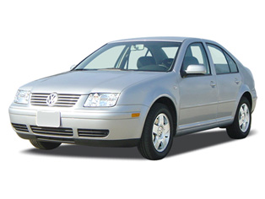
Future desire with would like to
Use would like to :
-to express future desires
?
unsure/
desire
Past
Present
Future
For example:
I don’t have a car, but
I would like to have a car
S + would + like + to + verb (bf) + compliment

Slide 3
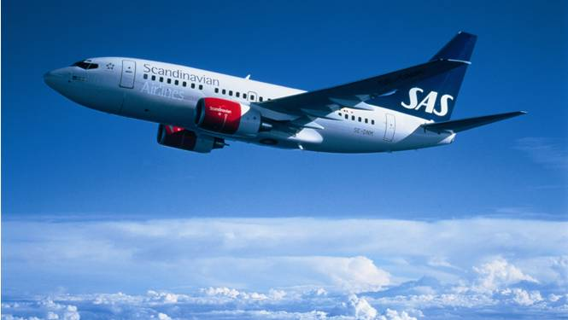
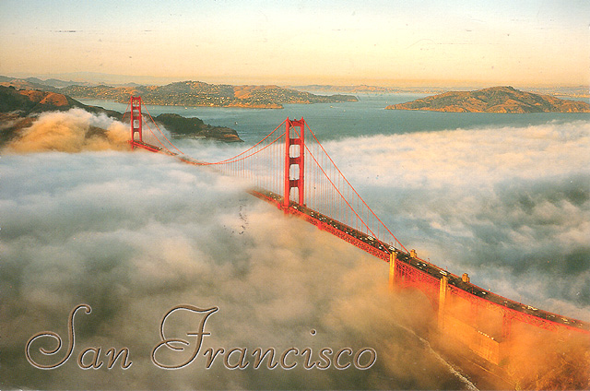
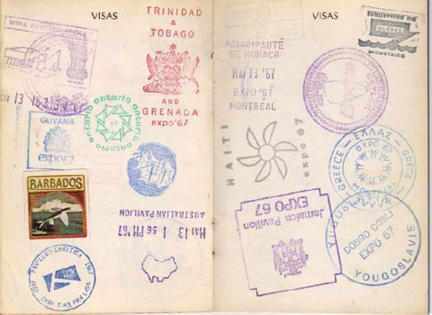
I like to travel a lot
I would like to visit San Francisco next year. (Future desire)
My passport.
(No San Francisco.)

Slide 4
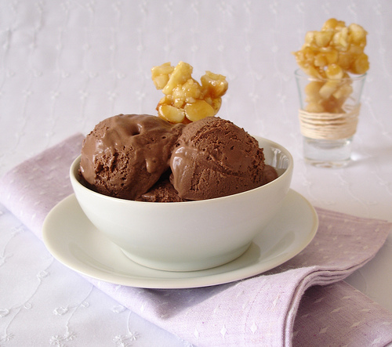
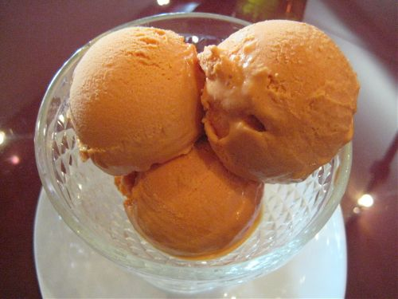
I like to eat chocolate ice cream.
But I would like to get lucuma ice cream next time I go to the store.
(for sure ? Not sure)

Slide 5
Questions with would you like
Wh- questions with would like to
Where
would
you
like to travel?
Wh- + would + S + like to + Verb (bf)
Yes/no questions with would like to
Would
you
like to study art?
Would + S + like to + Verb (bf)

Slide 6
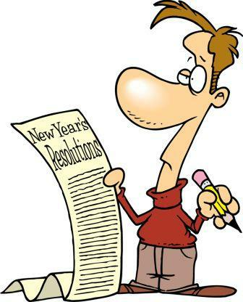
What would you like to change next year?
I like to paint, so I’d like to take a painting class

Slide 7

5-11 WOULD LIKE vs. LIKE
(a) I would like to play soccer.
(b) I like to play soccer.

Slide 8
(a) I would like to play soccer.
Want to
now or in the future
(b) I like to play soccer.
Enjoy
always, usually, often

Slide 9

would like
like
She _________ to visit the moon.
would like

Slide 10
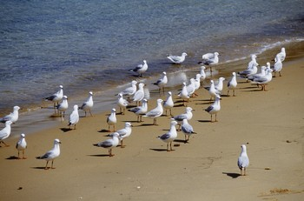
would like
like
Do you ______ to go to the beach?
like

Slide 11
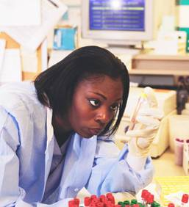
would like
like
would like
Someday, I __________ to be a scientist.

